Slide 1

Sharmistha Dey

Slide 2
CS50

Slide 3
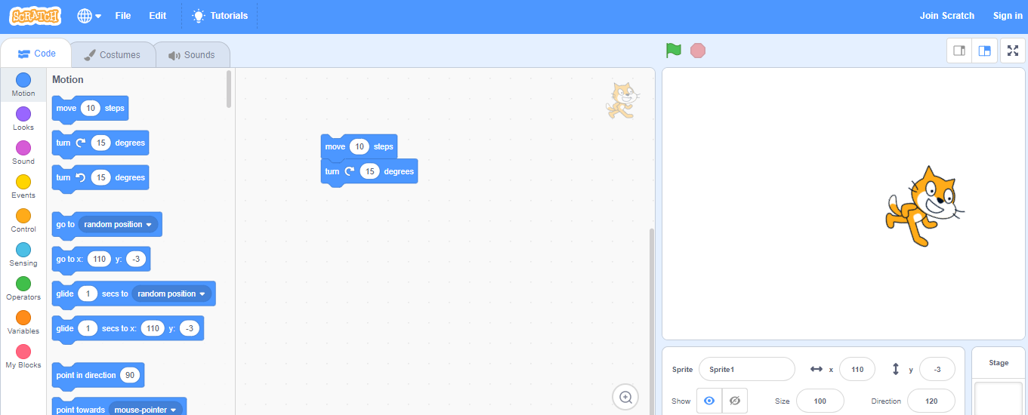
Scratch-
With scratch we can program our own interactive stories, games and animations and share our creations with others in the online community. It helps young people learn to think creatively, reason systematically and work collaboratively- essential skills for life in the 21st century. Scratch is a project of the lifelong kindergarten group at MIT Media Ltd. It is provided free of charge.
Scratch is designed especially for ages 8 to 16 but is used by people of all ages. Millions of people are creating scratch projects in a wide variety of settings, including homes, schools, museums, libraries and community centers.

Slide 4
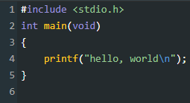
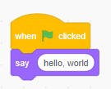
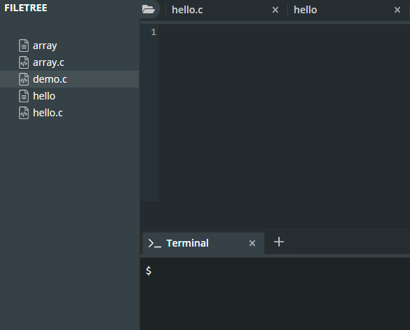
C-
A programming language that has all the features of Scratch and more, but perhaps a little less friendly since it’s purely in text:
CS50 IDE-

Slide 5
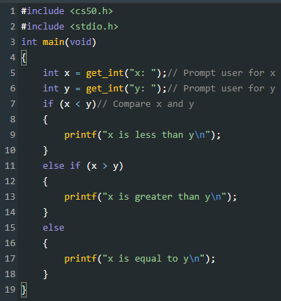
Data types-
The CS50 library has corresponding functions to get input of various types:
get_char
get_double
get_float
get_int
get_long
get_string

Slide 6
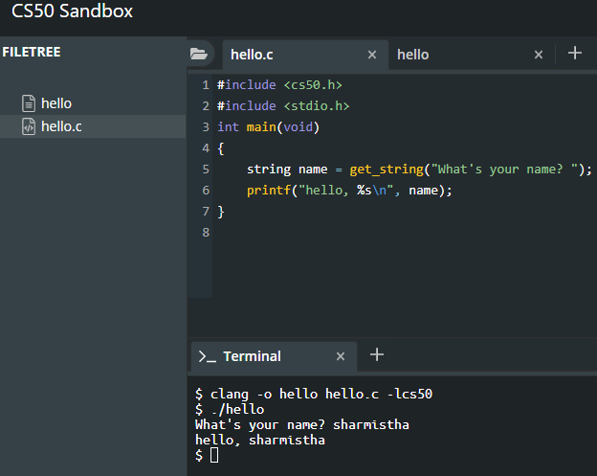
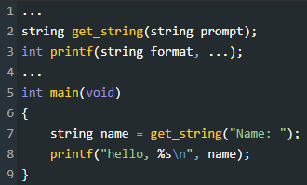
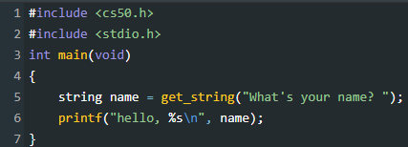
Arrays-
A list of values stored one after another contiguously is called an array.
Compiling-
Preprocessing-

Slide 7
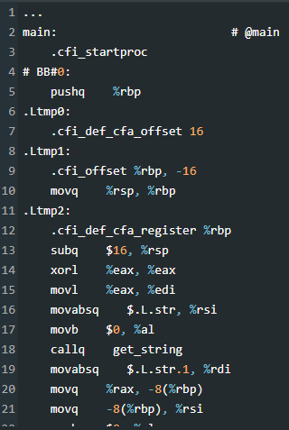
Assembling-
Linking-
The last step is linking, where previously compiled versions of libraries that we included earlier, like cs50.c, are actually combined with the binary of our program. So we end up with one binary file, a.out or hello, that is the combined machine code for hello.c, cs50.c and stdio.c.(In the CS50 IDE, precompiled machine code for cs50.c and stdio.c has already been installed, and clang has been configured to find and use them.)

Slide 8
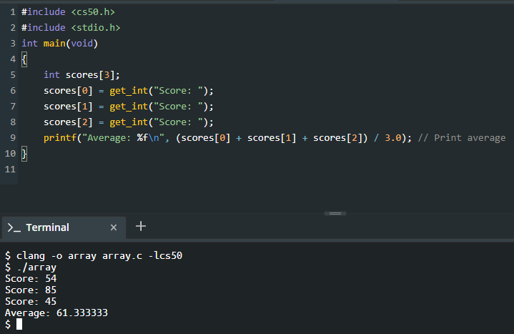
Example-

Slide 9
Memory-
we have different types of variables we can use for storing data, and each of them take up a fixed amount of space. Different computer systems actually vary in the amount of space actually used for each type, but we’ll work with the amounts here, as used in the CS50 IDE:
bool 1 byte
char 1 byte
double 8 bytes
float 4 bytes
int 4 bytes
long 8 bytes
string ? bytes
…
Hexadecimal-
It turns out that, by convention, the addresses for memory use the counting system hexadecimal, or base-16, where there are 16 digits: 0-9, and A-F as equivalents to 10-15.
Pointers- A variable that stores an address is called a pointer, which we can think of as a value that “points” to a location in memory. In C, pointers can refer to specific types of values.
We can use * operator for declare the pointer.

Slide 10
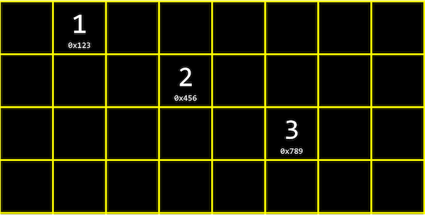
Data Structures-
Data structures are programming constructs that allow us to store information in different layouts in our computer’s memory.
To build a data structure, we’ll need some tools we’ve seen:
Struct to create custom data types
* to go to an address in memory pointed to by a pointer
. to access properties in a structure
Linked Lists-
With a linked list, we can store a list of values that can easily be grown by storing values in different parts of memory

Slide 11
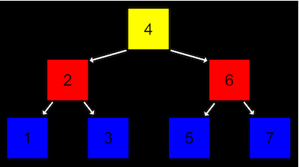
Tree-
A tree is another data structure where each node points to two other nodes, one to the left (with a smaller value) and one to the right (with a larger value):

Slide 12
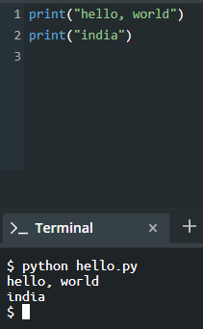
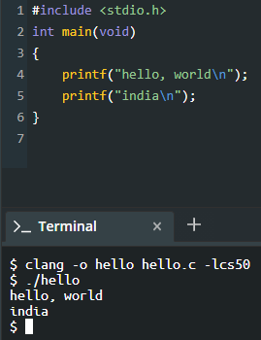
Python-
In Python, there are many data types:
bool, True or False
float, real numbers
int, integers
str, strings
range, sequence of numbers
list, sequence of mutable values, that we can change or add or remove
tuple, sequence of immutable values, that we can’t change
dict, collection of key/value pairs, like a hash table
set, collection of unique values

Slide 13
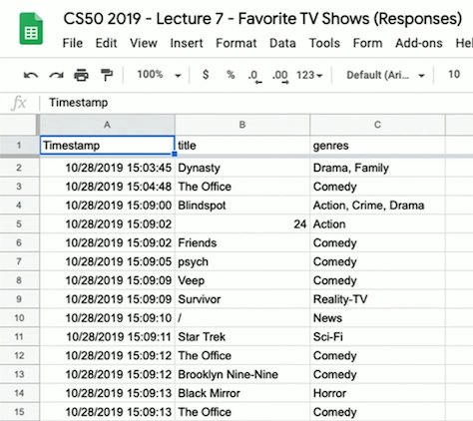
Spreadsheets-
A database is an application that can store data, and we can think of Google Sheets as one such application.
For example, we created a Google Form to ask students their favorite TV show and genre of it. We look thorugh the responses, and see that the spreadsheet has three columns: “Timestamp”, “title”, and “genres”:

Slide 14
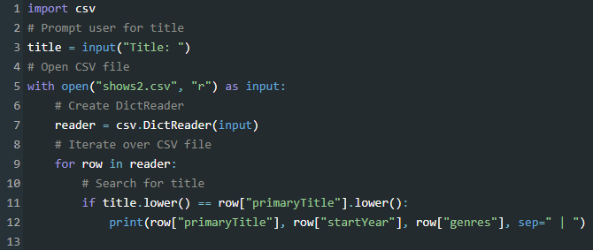
SQL-
It is structured query language.
SQLite is one database application that supports SQL, and there are many companies with server applications that support SQL, includes Oracle Database, MySQL, PostgreSQL, MariaDB, and Microsoft Access.
In SQL, the commands to perform each of these operations are:
INSERT
SELECT
UPDATE
DELETE

Slide 15
How To Write A Clean Code

Slide 16
What Is Clean Code-
Reading code should make you smile the way a well-crafted music box or well-designed car would. No matter how elegant it is, no matter how readable and accessible, without tests, it be unclean. Clean code is code that has been taken care of. Someone has taken the time to keep it simple and orderly. They have paid appropriate attention to details. They have cared.
Meaningful Names-
It is easy to say that names should reveal intent. What we want to impress upon you is that we are serious about this. Choosing good names takes time but saves more than it takes. So take care with your names and change them when you find better ones. Everyone who reads your code (including you) will be happier if you do.
Class Names –
Classes and objects should have noun or noun phrase names like:-
Customer , WikiPage , Account , and AddressParser
Avoid words like:-
Manager , Processor , Data , or Info in the name of a class.
Method Names-
Methods should have verb or verb phrase names like:-
postPayment , deletePage , or save
Variables Names-
Variables should be declared as close to their usage as possible. The name of a variable, function, or class, should answer all the big questions. It should tell you why it exists, what it does, and how it is used. If a name requires a comment, then the name does not reveal its intent.

Slide 17
Universal principles to follow-
DRY (Don’t Repeat Yourself)
SOLID (Follow SOLID principles to write clean classes and well organised APIs)
S :- Single Responsibility Principle (The single responsibility principle (SRP) asserts that a class or module should do one thing only)
O :- Open/Closed Principle (The Open/Closed Principle states that code entities should be open for extension, but closed for modification)
L :- Liskov Substitution Principle (The LSP says, basically, that any child type of a parent type should be able to stand in for that parent without things blowing up)
I :- Interface Segregation (The Interface Segregation Principle (ISP) says that you should favor many, smaller, client-specific interfaces over one larger, more monolithic interface)
D :- Dependency Inversion (The Dependency Inversion Principle (DIP) encourages you to write code that depends upon abstractions rather than upon concrete details)
Design pattern :- Follow a design pattern if it fits the problem space that you are trying to solve. This instantly makes your code much more accessible to fellow programmers
Law of Demeter :- Law of Demeter says that a method f of a class C should only call the methods of these:
• C
• An object created by f Don’t Be Cute Universal principles to follow
• An object passed as an argument to f
• An object held in an instance variable of C
Follow the three laws of Test-Driven Development (TDD), and keep your test code as clean as production code.
First Law: You may not write production code until you have written a failing unit test.
Second Law: You may not write more of a unit test than is sufficient to fail, and not compiling is failing.
Third Law: You may not write more production code than is sufficient to pass the currently failing test.

Slide 18
Functions-
A Function should do one thing only and do it really well.
A function should not return null
Do not pass boolean into a function, as there is supposed to be a if statement. Which causes it to do more than one thing.
A function should either do something or return something. if a function is returning boolean, then it should not do any operation with in a function.
Prefer Exceptions to returning Error Codes and extract error handling try catch into their own function.
Function should be read like a newspaper, It will be a good practice to avoid long lines of horizontal code. Because Our eyes are more comfortable when reading tall and narrow columns of text.
Object and data structures-
Variables should be private so that we can change their type or implementation when required. There is no need to add getters/setter to each variable to expose them as public.
Hiding implementation is not just a matter of putting a layer of functions between the variables. Hiding implementation is about abstractions! We do not want to expose details of data but rather express data as abstract terms
Tests-
Clean tests should follow F.I.R.S.T principles:
Fast: Tests should be fast. They should run quickly. When tests run slow, you won’t want to run them frequently
Independent: Tests should not depend on each other. One test should not set up the Functions Object and data structures Tests conditions for the next test. You should be able to run each test independently and run the tests in any order you like.
Repeatable: Tests should be repeatable in any environment. They should run in the production environment, the QA environment, and even on your laptop while riding home on the train without a network.
Self-Validating: The tests should have a boolean output. Either they pass or fail. You should not have to read through a log file to tell whether the tests pass.
Timely: The tests need to be written in a timely fashion.

Slide 19
Google Style Guide and Git Basics

Slide 20
Google Style Guide-
Every major open-source project has its own style guide: a set of conventions (sometimes arbitrary) about how to write code for that project. It is much easier to understand a large codebase when all the code in it is in a consistent style.
“Style” covers a lot of ground, from “use camelCase for variable names” to “never use global variables” to “never use exceptions.” This project (google/styleguide) links to the style guidelines we use for Google code. If you are modifying a project that originated at Google, you may be pointed to this page to see the style guides that apply to that project.
This project holds the C++ Style Guide, C# Style Guide, Swift Style Guide, Objective-C Style Guide, Java Style Guide, Python Style Guide, R Style Guide, Shell Style Guide, HTML/CSS Style Guide, JavaScript Style Guide, AngularJS Style Guide, Common Lisp Style Guide, and Vimscript Style Guide.

Slide 21
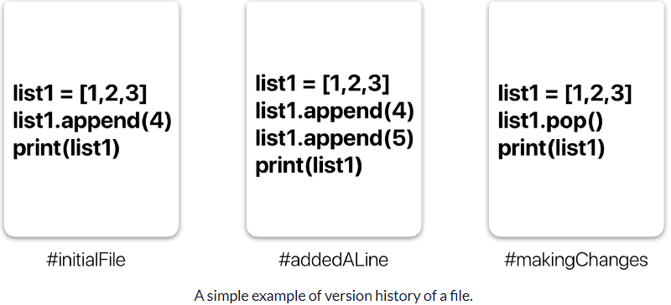
Git-
It is a distributed revision control and source code management system with an emphasis on speed. Git was initially designed and developed by Linus Torvalds for Linux kernel development.
Features-
Distributed
Compatible
Non Linear
Branching
Light weight
Speed
Open source
Reliable
Secure
Economical

Slide 22
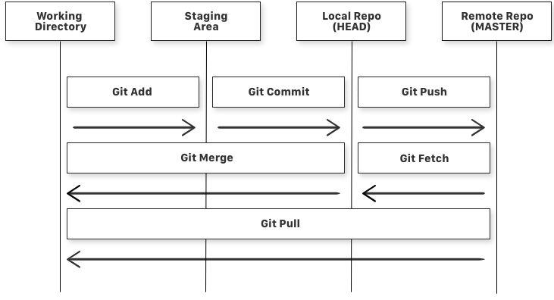
General workflow is as follows −
You clone the Git repository as a working copy.
You modify the working copy by adding/editing files.
If necessary, you also update the working copy by taking other developer's changes.
You review the changes before commit.
You commit changes. If everything is fine, then you push the changes to the repository.
After committing, if you realize something is wrong, then you correct the last commit and push the changes to the repository.

Slide 23
Advantages of Git-
Free and open source-
Git is released under GPL’s open source license. It is available freely over the internet. You can use Git to manage property projects without paying a single penny. As it is an open source, you can download its source code and also perform changes according to your requirements.
Fast and small-
As most of the operations are performed locally, it gives a huge benefit in terms of speed. Git does not rely on the central server; that is why, there is no need to interact with the remote server for every operation. The core part of Git is written in C, which avoids runtime overheads associated with other high-level languages. Though Git mirrors entire repository, the size of the data on the client side is small. This illustrates the efficiency of Git at compressing and storing data on the client side.
Implicit backup-
The chances of losing data are very rare when there are multiple copies of it. Data present on any client side mirrors the repository, hence it can be used in the event of a crash or disk corruption.
Security-
Git uses a common cryptographic hash function called secure hash function (SHA1), to name and identify objects within its database. Every file and commit is check-summed and retrieved by its checksum at the time of checkout. It implies that, it is impossible to change file, date, and commit message and any other data from the Git database without knowing Git.
No need of powerful hardware-
In case of CVCS, the central server needs to be powerful enough to serve requests of the entire team. For smaller teams, it is not an issue, but as the team size grows, the hardware limitations of the server can be a performance bottleneck. In case of DVCS, developers don’t interact with the server unless they need to push or pull changes. All the heavy lifting happens on the client side, so the server hardware can be very simple indeed.
Easier branching-
CVCS uses cheap copy mechanism, If we create a new branch, it will copy all the codes to the new branch, so it is time-consuming and not efficient. Also, deletion and merging of branches in CVCS is complicated and time-consuming. But branch management with Git is very simple. It takes only a few seconds to create, delete, and merge branches.

Slide 24
Thank You

